Slide 1
Epic Meal Slime
Rebecca Tester & Matthew Satterfield

Slide 2

High Concept
Help a hungry slime in a big city navigate through pillars and get food by clicking when it’s safe to snack.

Slide 3
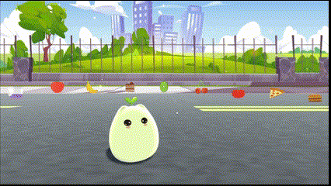
Menu Tweening
The UI elements in all scenes tween in position, rotation, and size onto the screen.

Slide 4
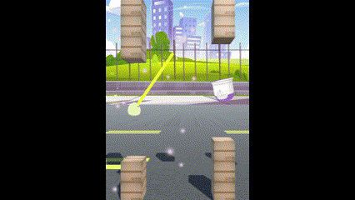

Player Animations
The slime now has an idle and jump animation.

Slide 5
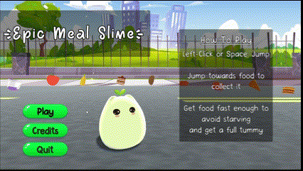
Buttons
The buttons both wobble and grow when you hover over them.

Slide 6
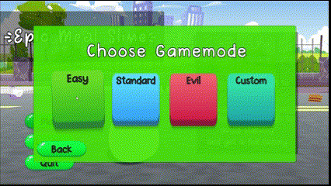
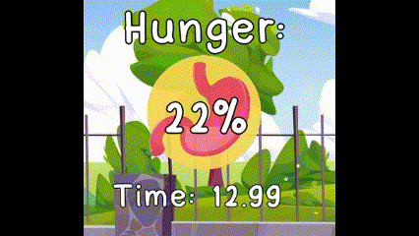
Other
Screen Transitions
Countdown
Reticle wobble
Hunger UI pop

Slide 7
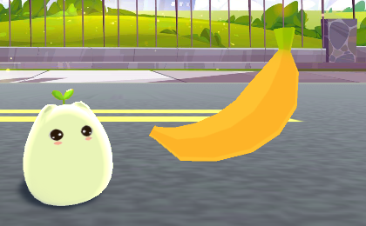
Genre & Theme
Colorful Casual Action
Fantasy and Food
Notes:
Game based off the Omnivore theme

Slide 8


Core Mechanics
Aiming and Jumping through pillars to get food.
Get food to avoid starving.
Get food quickly enough to fill up the slime’s hunger completely and win.

Slide 9
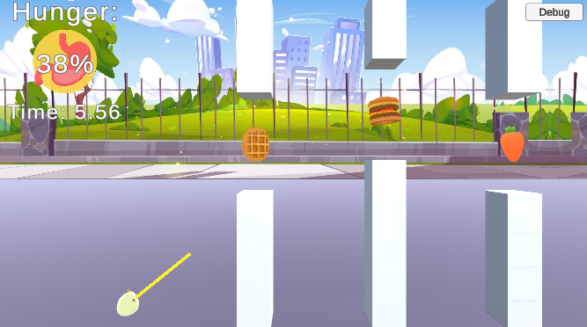
Gameplay
Jumping - Click or press Space.
Aiming - Automatic. Time your jumps.
Hunger - Depletes, but food increases. 0% lose, 100% win.
Notes:
Jumping - Click or press Space to jump and advance to the next pillar
Aiming - An aiming line automatically goes up and down, time your jumps to go through the pillars and get food.
Hunger - Your hunger depletes over time and increases when you get food. Reach 0% and you starve, but reach 100% and you win.

Slide 10

Fun Factor
Trying to beat your best time.
Tension between hunger depleting and aiming.
Easy replayability.

Slide 11
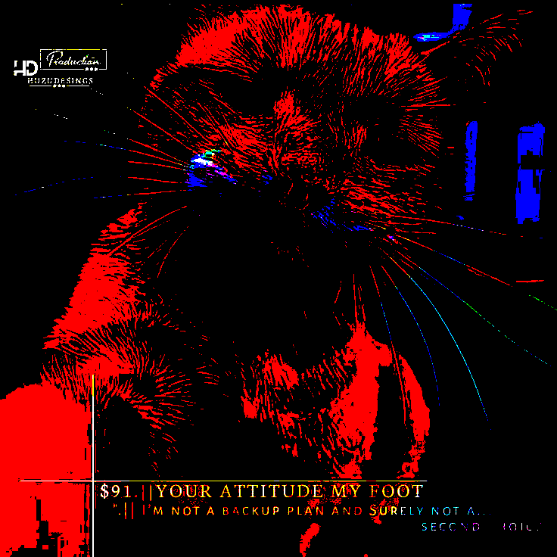

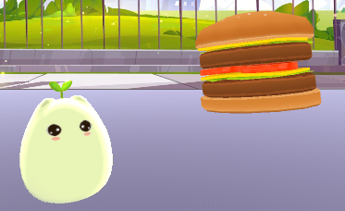
Images in presentation, delete this slide when done

